Slide 1
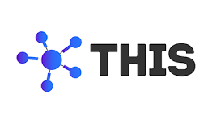

Ticket Booking System
Done By:
Nayana Dhananjaya
Venkata Merapureddy
Gunasri Bollineni
Neelam Rana
Harsha Moturu
Neha Syed
Team I

Slide 2
Contents
Problem Statement
Detail Description
Design/Architecture
Technologies Used
Screenshots

Slide 3
Problem statement
This Application involves generating a train ticket and printing the ticket to a File.
The application should take train number and passenger details as input.

Slide 4
Description
The home page contains two logins User Login and Admin Login.
In the application the user can login or register, the user can also use their social logins.
The user can view trains and can book a ticket and view, download the ticket.
The admin can add,view, update, delete trains.

Slide 5
Architecture
Admin Login
Admin Home page
Train
Home Page
Train
User Home Page
User Register/Login
Ticket

Slide 6
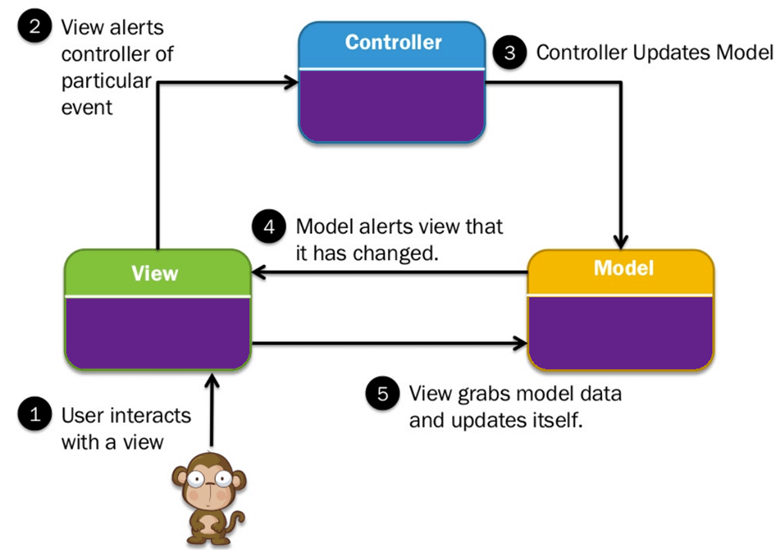
MVC Architecture

Slide 7

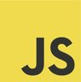
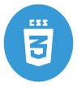
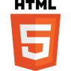

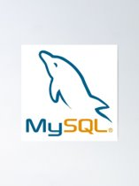
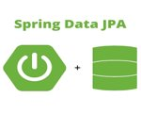

Technologies used
Html
CSS
Java Script
Spring JPA
Rest API
MYSQL

Slide 8

Screenshots

Slide 9
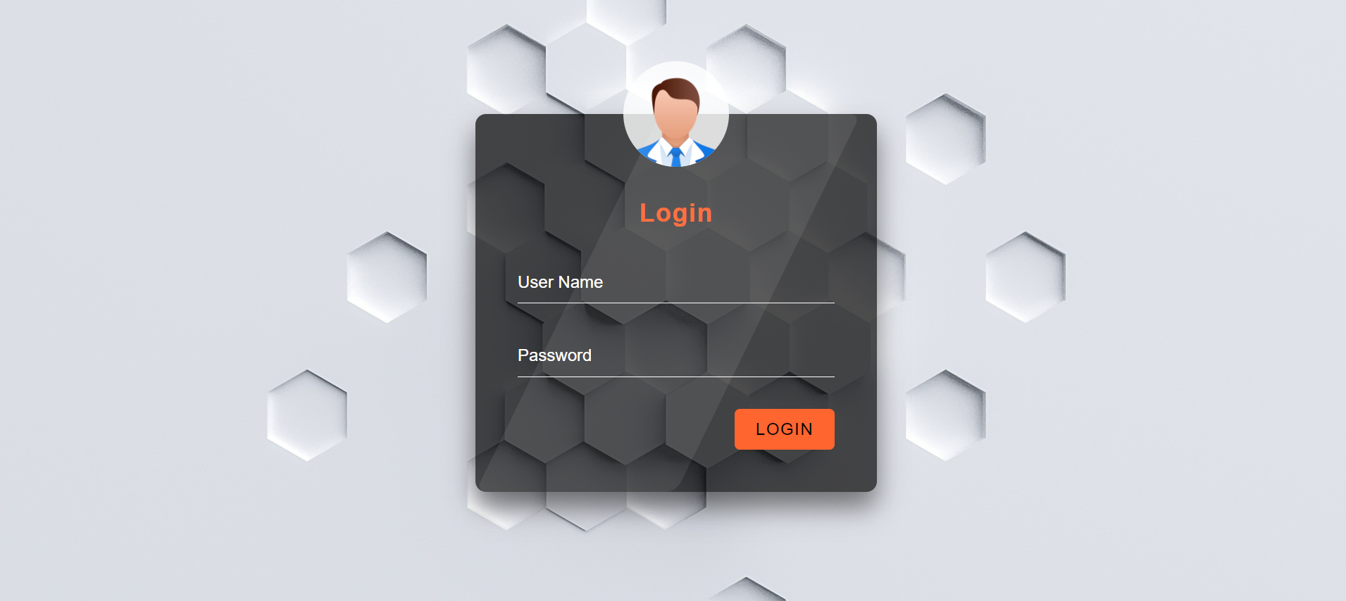
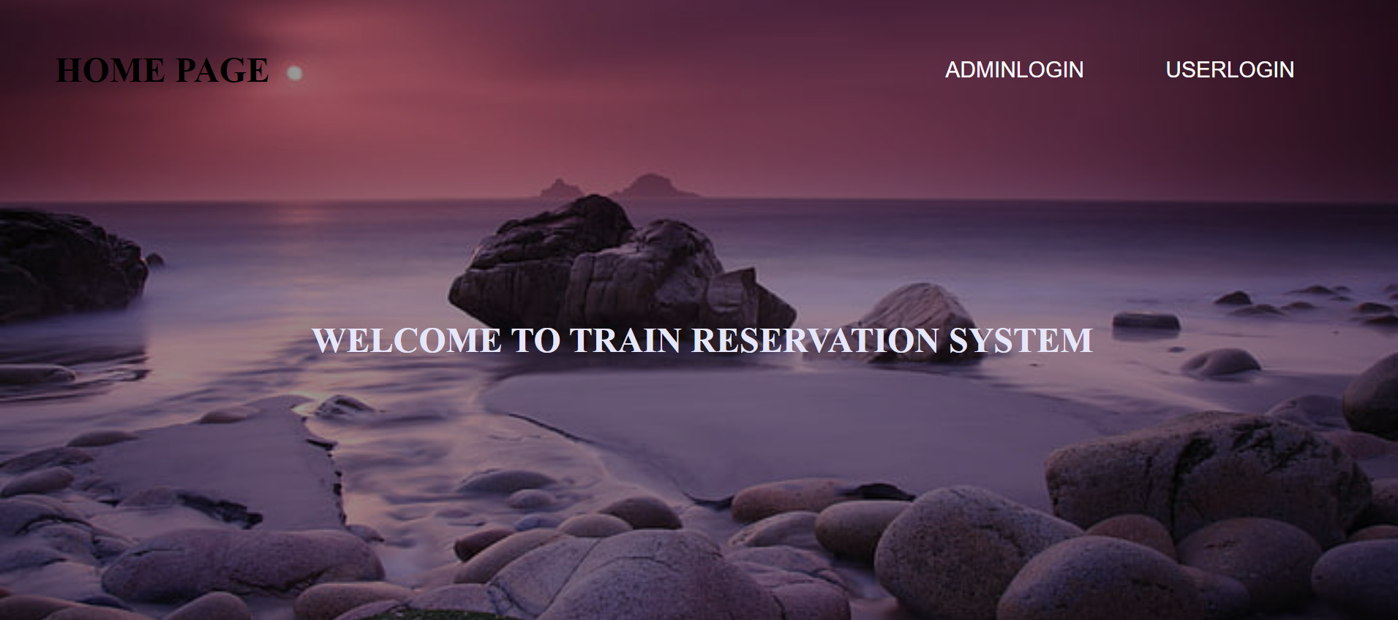

Slide 10
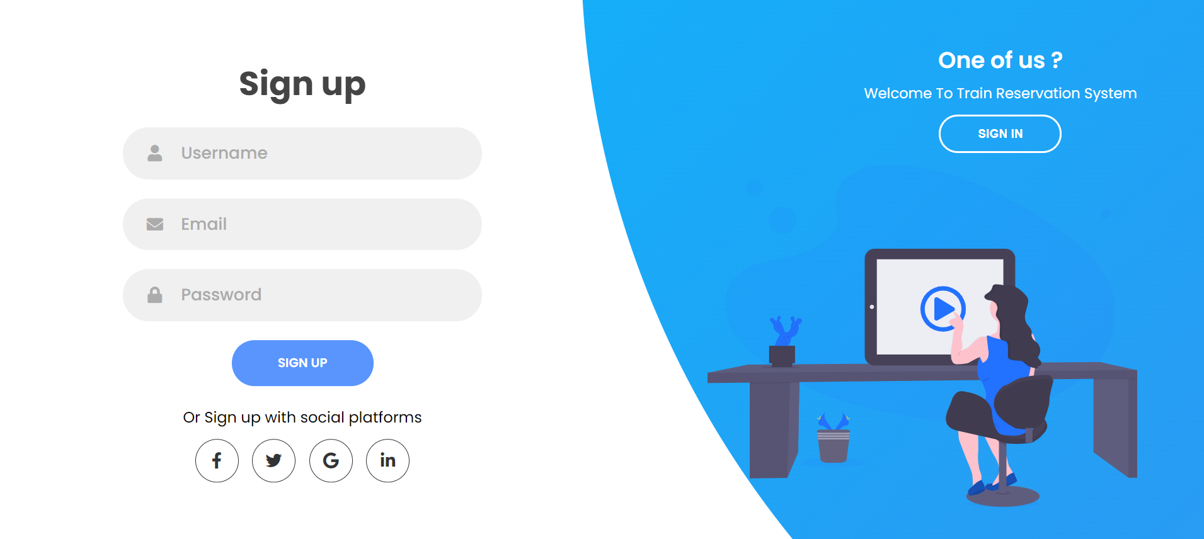
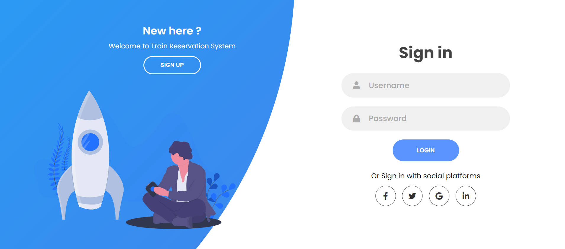

Slide 11
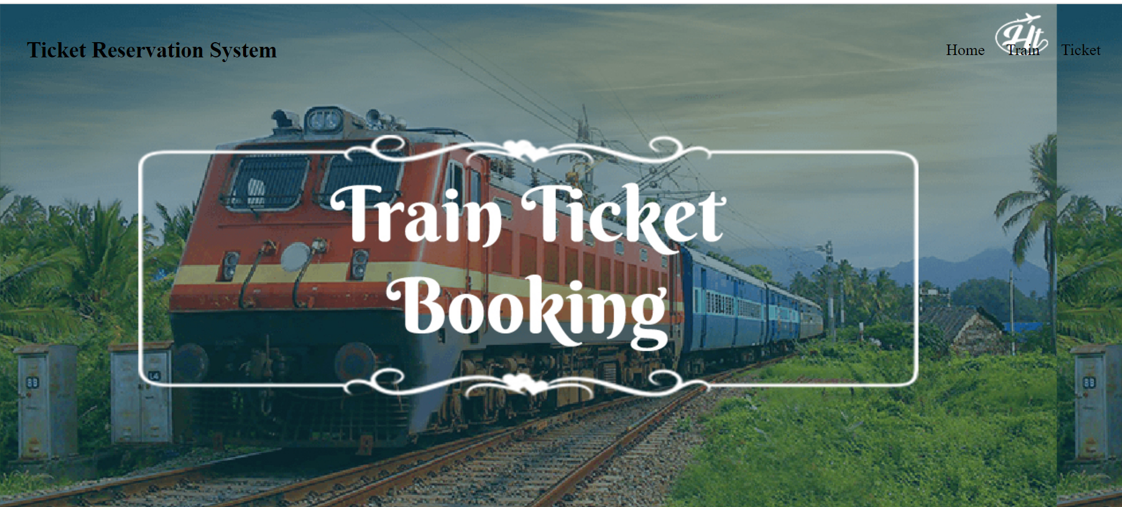
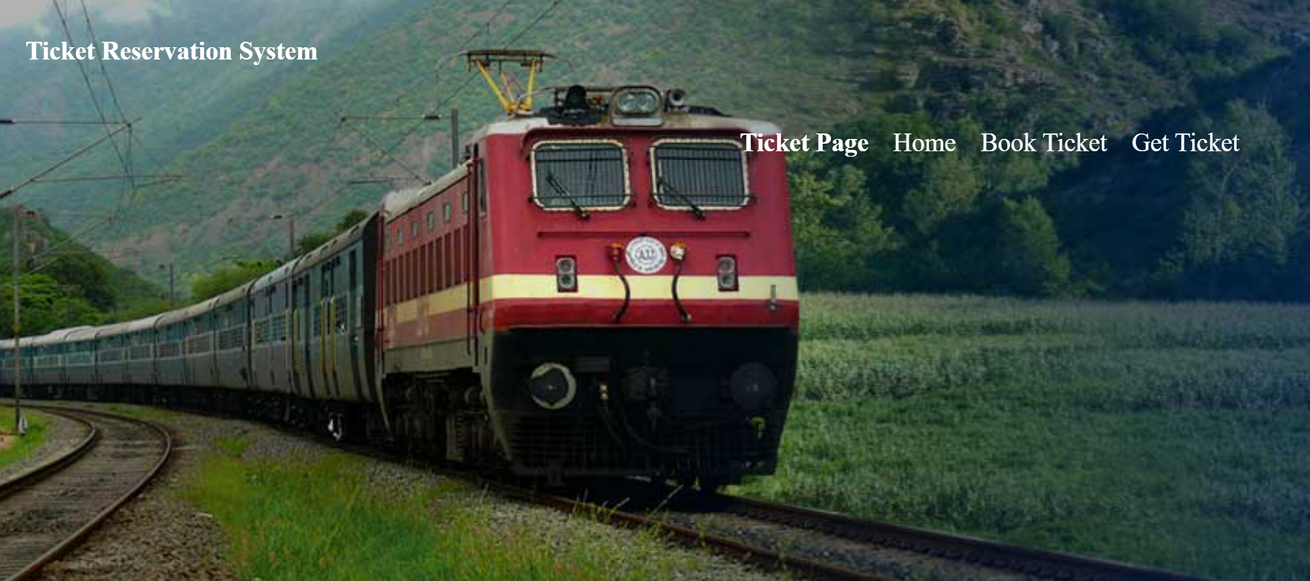
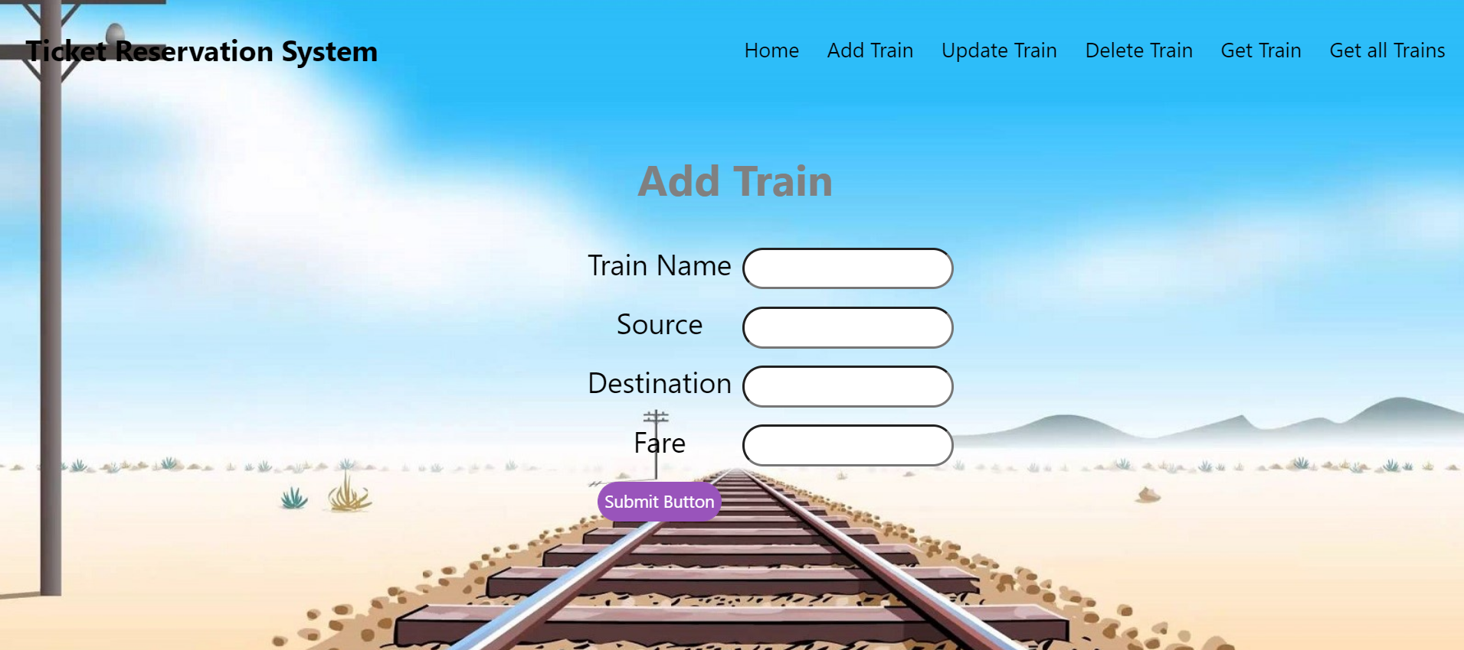

Slide 12
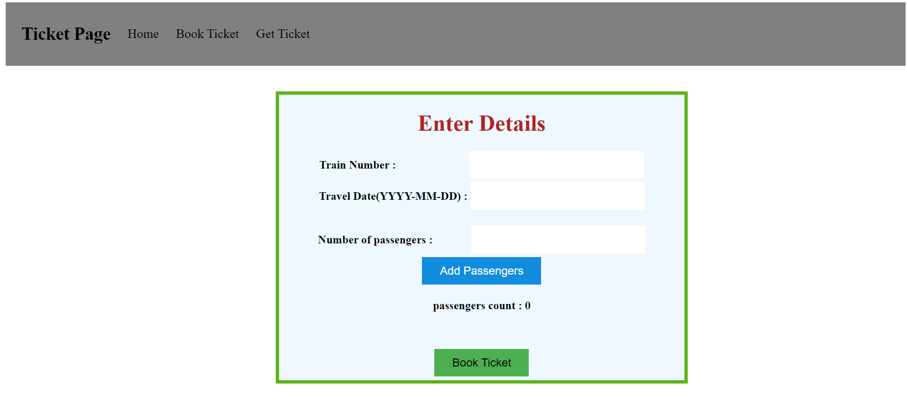
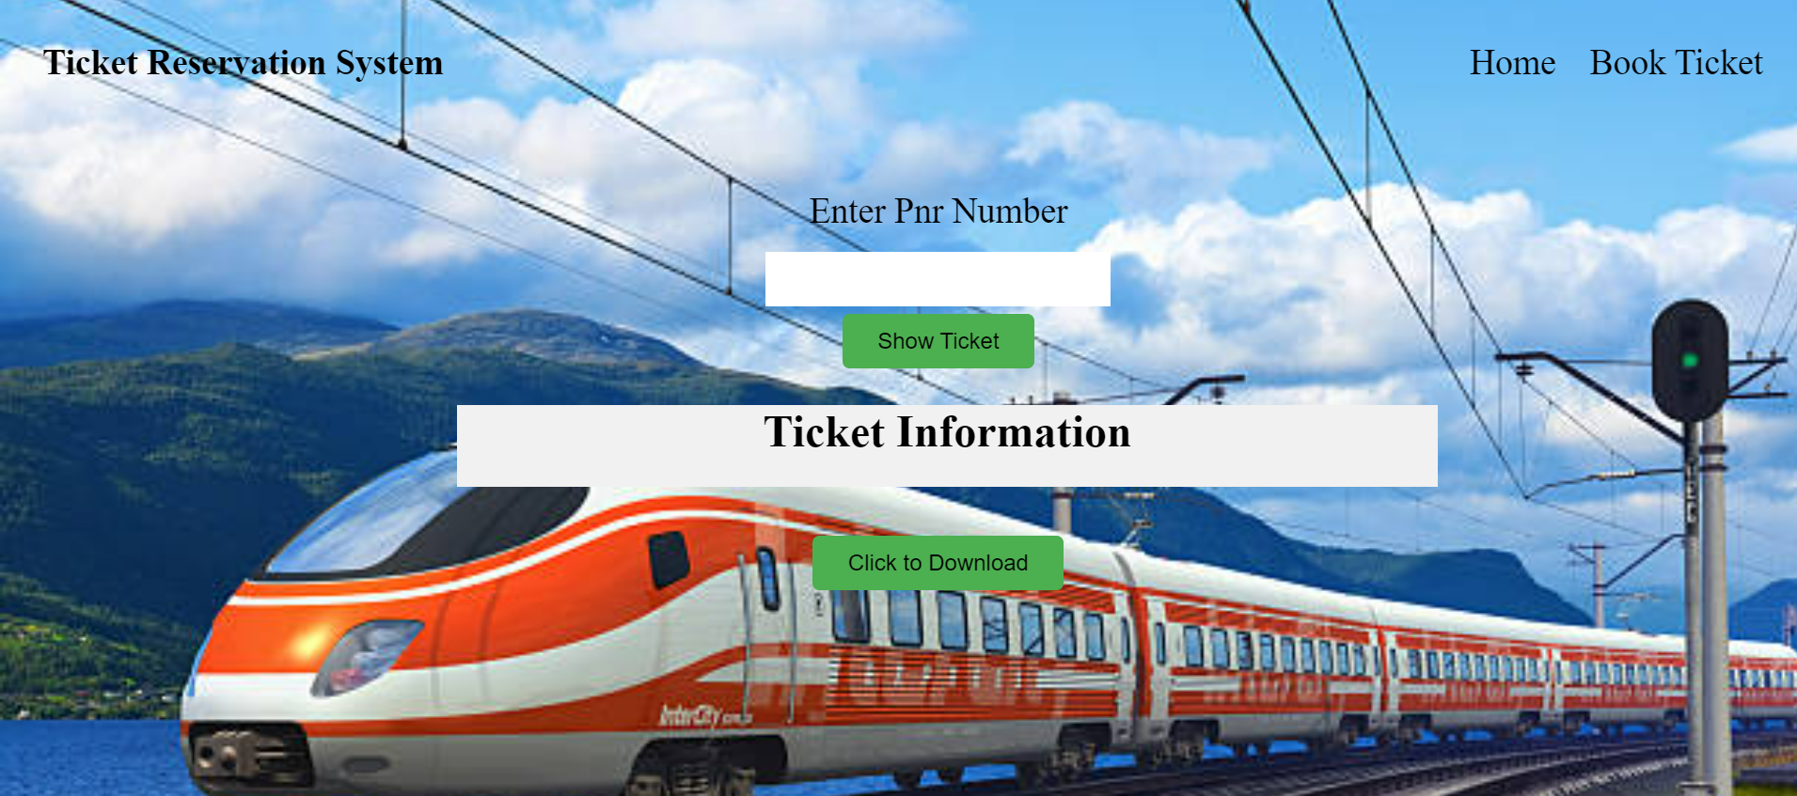

Slide 13

Thank you

